Slide 1






Optimizing Deposit
Marketing Campaigns
Machine Learning Based Customer Prioritization
Risman Sudarmaji

Slide 2




Context
Ranking and business impact
01
Context and objective
04
Data understanding & EDA
Recomendation and limitation
02
05
03
Modeling and validation

Slide 3

Section 1
Context and
Objective
Why does customer prioritization matter?

Slide 4
Business Problem & Model Objectives
Business Problem
Business Objective
ML Objective
Menghubungi seluruh nasabah membutuhkan biaya dan tenaga, sementara potensi respons antar nasabah berbeda-beda.
Meningkatkan efektivitas pemilihan nasabah yang menjadi target marketing dengan telepon untuk menjaga pengeluaran anggaran marketing.
Memperkirakan skor probabilitas deposito dan mengurutkan nasabah sebelum terjadi aktifitas kontak nasabah.
Which customers should be contacted first?

Slide 5

Section 2
Data &
Understanding
Data sources, cleaning, and exploratory insights

Slide 6
Data Foundation & Feature Selection
RAW DATA
CLEAN DATA
TRAIN / TEST
7,813
7,805
80 : 20
Setelah menghapus 8 baris identik
6,244 training; 1,561 testing
7 pre campaign input features
age • job • balance • housing • loan • pdays • poutcome
Target: deposit (Yes / No). Fitur campaign, contact, month tidak digunakan dalam model awal.

Slide 7
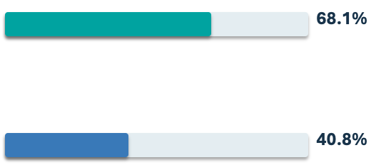
Key Exploratory Data Analysis Insights
Previous contact history
Student
74.49%
Previously contacted
Subscription rate historis
Blue Collar
37.44%
Not Previously contacted
Subscription rate historis

Slide 8

Section 3
Modeling &
Evaluation
From preprocessing to model selection

Slide 9

Machine Learning Pipeline
01
02
03
04
05
06
Clean Data
7 features
Feature Engineering
One Hot Encoding + Scaling
Benchmark 3 Algorithms
Tuning 5 Fold CV
Top K Rangking
Strategi evaluasi: Stratified 5 Fold CV → OOF Ranking → Test Set final

Slide 10
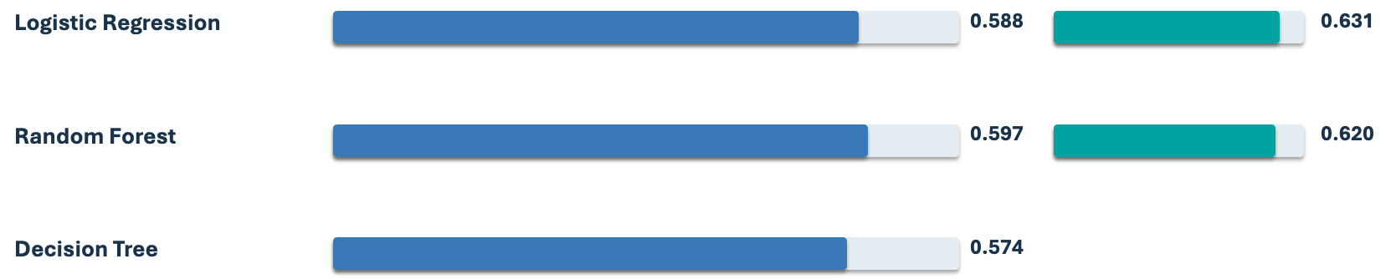
Benchmarking & Hyperparameter Tuning
Blue = baseline F1 | Green = tuned F1
Logistic Regression F1 tuned 0,6310. Random Forest F1 tuned 0,6196.
Pilihan akhir berdasarkan ranking.

Slide 11
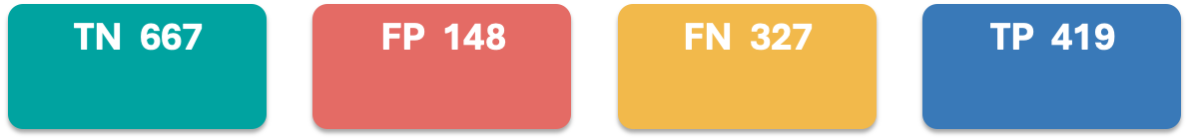
Final Model Performance: Random Forest
Evaluated on 1,561 customers in the test set
Accuracy
Precision
Recall
F1 Score
ROC - AUC
69.57%
73.90%
56.17%
63.82%
73.75%
Confusion Matrix

Slide 12
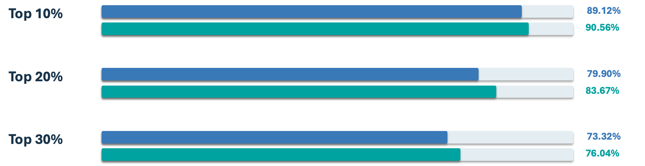
Customer Ranking
OOF evaluation favored Random Forest at Top 10%, 20%, and 30%
Blue: Logistic Regression | Green: Random Forest
Perbandingan menggunakan probabilitas OOF pada training set. Hyperparameter telah dipilih dari data yang sama.

Slide 13
Customer Ranking. Random Forest
Test set 1,561
rank customers by predicted scores
Top 10%
Top 20%
Top 30%
89.81%
84.98%
77.40%
141 positive / 157 selected
Recall 18.90%
Lift 1.88x
266 positive / 313 selected
Recall 35.66%
Lift 1.78x
363 positive / 469 selected
Recall 48.66%
Lift 1.62x

Slide 14

Section 4
Business Impact &
Decision Making
Comparing model based and random customer selection

Slide 15
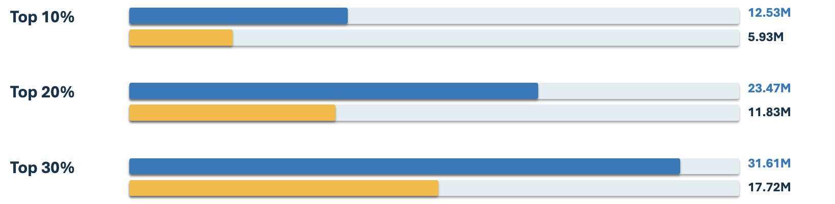
Simulated Business Benefit: ML vs Random
Illustrative assumptions. IDR 10,000 per contact and IDR 100,000 per historically positive customer
Blue = simulated ML net benefit | Yellow = estimated random targeting net benefit

Slide 16
Capacity Trade off’s. Efficiency vs. Total Benefit
Higher outreach capacity increases simulated total net benefit but reduces ROI
Top 10%
Top 20%
Top 30%
798.09%
749.84%
673.99%
ROI simulation
ROI simulation
ROI simulation
Rp. 12.53 M
Rp. 23.47 M
Rp. 31.61 M
Net benefit
Net benefit
Net benefit
20% teratas merupakan titik awal PILOT yang diusulkan. Tapi bukan titik optimal yang ditetapkan.

Slide 17
How ML based customer prioritization works
01
02
03
04
7 INPUT FEATURES
Pre-campaign profile
and contact history
RANDOM FOREST
Preprocessing +
predicted scores
CUSTOMER RANKING
Highest scores
first
TOP 20% PILOT
Treatment vs
randomized control
Pilot metrics: actual conversion rate • incremental net benefit • cost per conversion • ranking stability

Slide 18
Conclusions & Implementation Recommendations
Random Forest supports customer prioritization. It is not a fully automated decision system
01
Rank customers by propensity
Prioritize outreach by model score within business capacity constraints.
Validate through a pilot campaign
02
Compare model targeting with a randomized control to measure actual impact.
03
Monitor and calibrate
Track data drift, ranking quality, costs, and probability calibration.
04
Ensure security & reproducibility
Preserve the pipeline, feature engineering module, library versions, and documentation.

Slide 19
What the results demonstrate and what they do not
SUPPORTED BY TEST DATA
ASSUMPTION BASED
NOT YET ESTABLISHED
84.98% Precision@20%
266 positive labels among 313 selected 1.78× historical positive-rate lift
IDR 23.47M net benefit at
Top 20% IDR 11.64M difference vs random Based on assumed costs and benefits
Actual incremental deposit conversions Realized ROI or net profit The truly optimal contact capacity
Recommendation: start with Top 20% as an initial pilot. Scale only after measured incremental value justifies cost.

Slide 20


Thank you

